Slide 1




𝖣𝖠𝖳𝖠𝖲𝖤𝖳’25
ECDS
AI Assignment Grading Assistant
TEAM NAME: ARMS CODERS

Slide 2
𝖣𝖠𝖳𝖠𝖲𝖤𝖳’25
ECDS
PROBLEM STATEMENT:
Instructors spend significant time evaluating assignments, especially for descriptive and technical answers, which slows down the feedback cycle.
Students often receive only a score without understanding which concepts were missing or incorrectly explained, limiting learning improvement.
Current automated tools provide marks without justification, making them difficult for teachers to trust and students to accept. Therefore, an ideal system should combine automation with explainability and rubric-driven scoring.
Tools like ChatGPT-based graders, automated essay scoring systems, and LMS auto-graders mainly output final marks or generic feedback, without clearly showing how scores are derived from rubrics or concepts, making them hard to trust for serious evaluations.

Slide 3
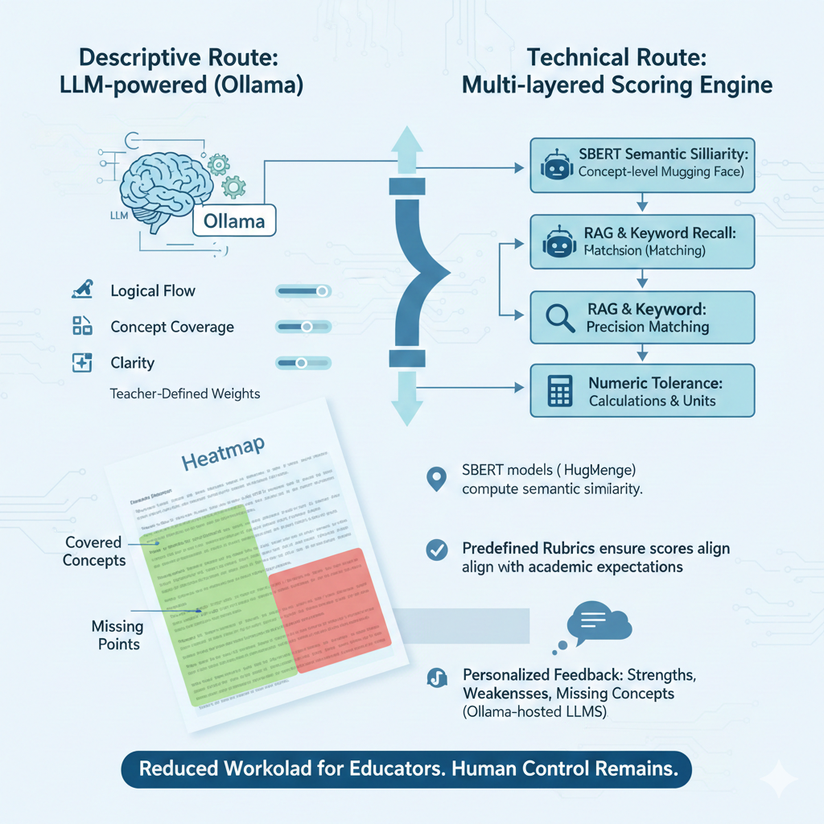
:
𝖣𝖠𝖳𝖠𝖲𝖤𝖳’25
SOLUTION:
ECDS
Smart Routing & Scoring: Auto-routes answers to LLM (descriptive) or ML + rules (technical) pipelines using rubric-aligned SBERT, RAG, and numeric tolerance.
Clear Feedback: Ollama LLMs generate personalized feedback + heatmap (covered vs missing concepts), reducing workload while keeping human control.

Slide 4
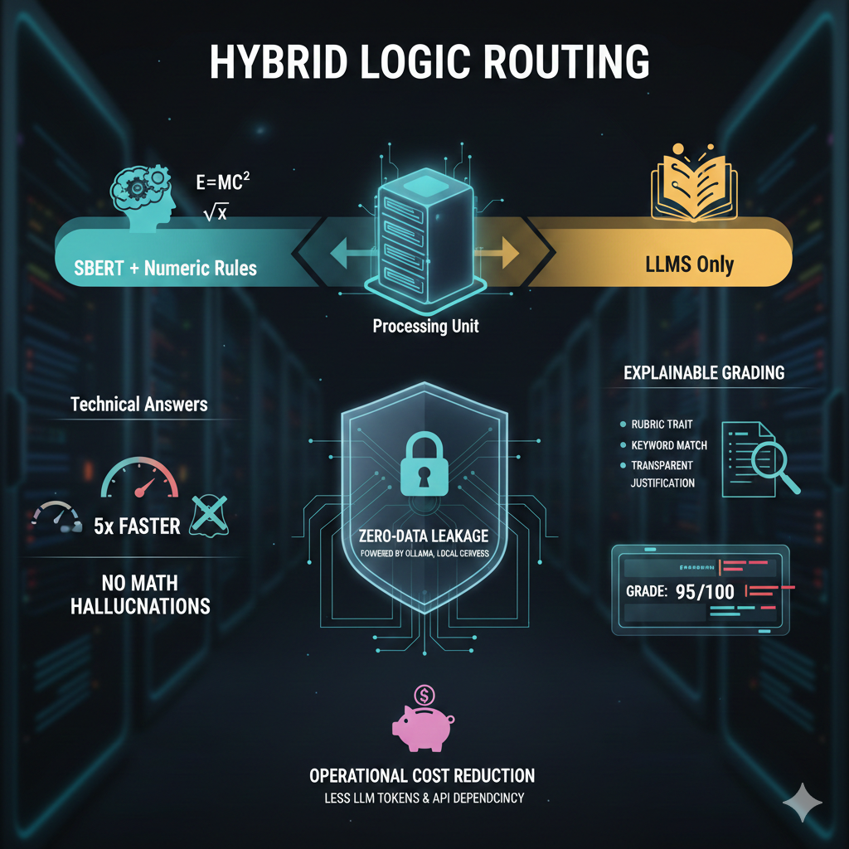
+
𝖣𝖠𝖳𝖠𝖲𝖤𝖳’25
INNOVATION & USP
ECDS
Hybrid Logic Routing: SBERT + numeric rules for technical answers, LLMs only for descriptive, enabling 5× faster evaluation and no math hallucinations.
Efficient & Explainable: Low LLM cost via deterministic scoring, with fully explainable, rubric-linked marks and local (Ollama) zero-data-leakage processing.

Slide 5
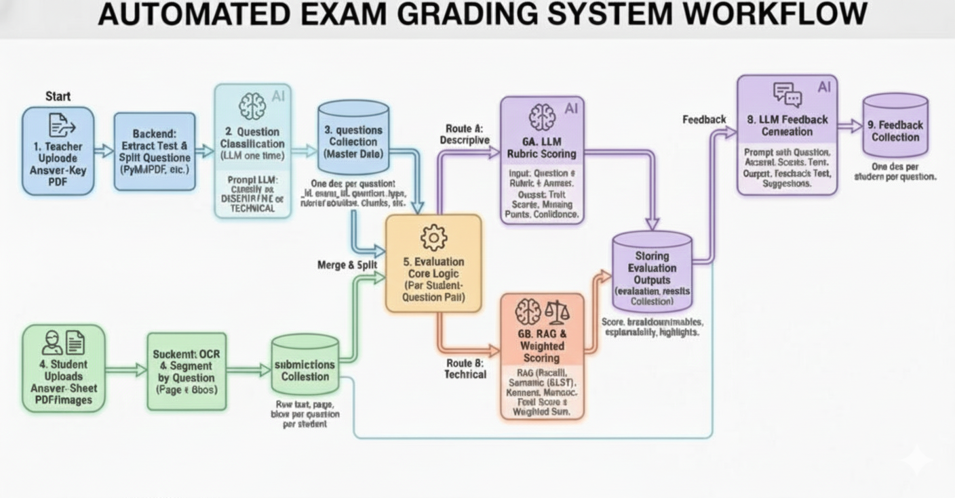
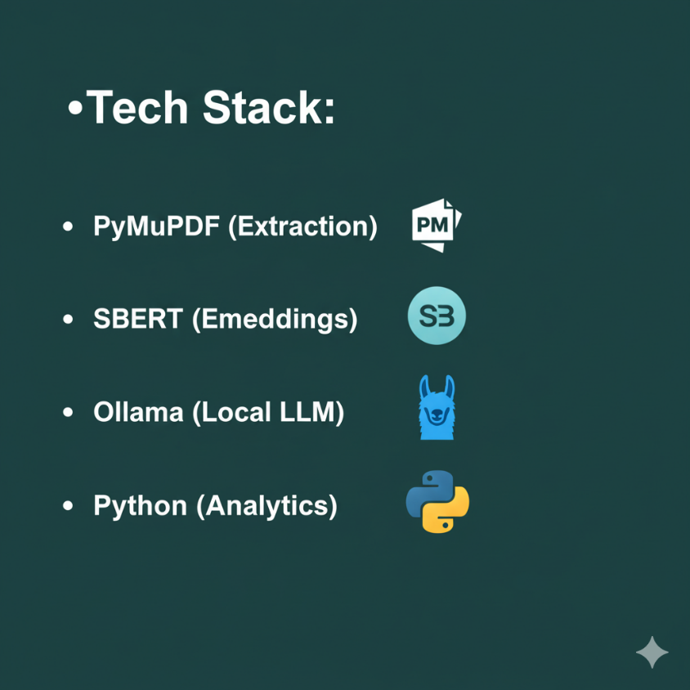


Include
𝖣𝖠𝖳𝖠𝖲𝖤𝖳’25
ECDS
WORKFLOW DIAGRAM:
MongoDB (Database)
JavaScript (Frontend)

